Slide 1
Supervised learning: Decision trees and linear regression

Slide 2

Supervised Learning
X₁ | X₂ | X₃ | … | X_{n-2} | X_{n-1} | X_{n} | Y
x_{1,1} | x_{2,1} | x_{3,1} | … | x_{n-2,1} | x_{n-1,1} | x_{n,1} | y₁
x_{1,2} | x_{2,2} | x_{3,2} | … | x_{n-2,2} | x_{n-1,2} | x_{n,2} | y₂
. . . | . . . | . . . | … … … | . . . | . . . | . . .
x_{1,m-1} | x_{2,m-1} | x_{3,m-1} | … | x_{n-2,m-1} | x_{n-1,m-1} | x_{n,m-1} | y_{m-1}
x_{1,m} | x_{2,m} | x_{3,m} | … | x_{n-2,m} | x_{n-1,m} | x_{n,m} | y_{m}
$$\hat{Y}=f\left(X_{1},X_{2},…,X_{n}\right)$$

Slide 3
The look alike idea
Observations that have “similar” values of explaining features tend to have similar values of outcome.

Slide 4
Decision trees and linear regression
In this session we will describe two simple yet practical and powerful methods:
Decision trees, which can be used for both classification and regression
Linear regression, which is a regression method

Slide 5
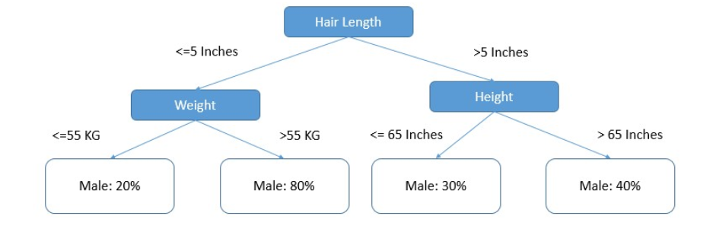
Decision trees
Decision trees are highly natural models for inference:

Slide 6
Decision trees
Decision trees can be induced from data.
Example:
We collected 5K results of some test.
Each result is described by many features, like features that describe the tested unit, results of previous tests, that the unit went through, the specific tester that run the test, etc.
4K tests were passed successfully, and 1K tests were failed.
The objective: predict the result of the test (success / fail) without actually running it.

Slide 7
Decision trees
The population is a mix of different types. What if we could find splitting criterion that will create two (or more), more pure sub populations
1,000 F
4,000 S
Tester 1
600 F
800 S
Testers 2, 3 & 4
400 F
3,200 S

Slide 8
Decision trees
Now, we can take each sub-population and split it recursively, until some stopping criteria are met.
1,000 F
4,000 S
Tester 1
600 F
800 S
Testers 2, 3 & 4
400 F
3,200 S

Slide 9
Decision trees
Estimation / Prediction
Given a new observation, we can sort id down the tree, according to the value of its features, until it reaches a leaf node.
In classification tasks, the tree returns a probability distribution over the possible outcomes (and it is our role to infer on a specific crisp classification, if such classification is needed).
In regression tasks, the tree typically returns the average outcome value.

Slide 10
How to induce a decision tree from data
Two main questions in order to automatically induce a decision tree from a given data set:
How to select the split in each node?
When to stop splitting

Slide 11
How to select the split in each node
Splitting is made according to values of explaining features
Binary splits are more common:
In binary features – one value to the left and the other to the right
In numeric features – up to a threshold to the left and from the threshold to the right
Multi valued categorial features are encode to binary dummy variables
That is: search over all the possible binary splits (maybe with some heuristic on potential threshold) and select the split that maximize some optimization criterion

Slide 12
Splitting by minimum misclassification
Class: +
Misclassifications: 90
100 +
90 -
Class: +
Misclassifications: 15
80 +
15 -
20 +
75 -

Slide 13
Few more successful splitting criteria
Maximum Information Gain (maximum reduction in entropy)
Maximum Gain Ratio:
The more possible values there are the higher is information gain that can be achieved
Gain ratio normalizes the information gain to compensate on that
Gini Index

Slide 14
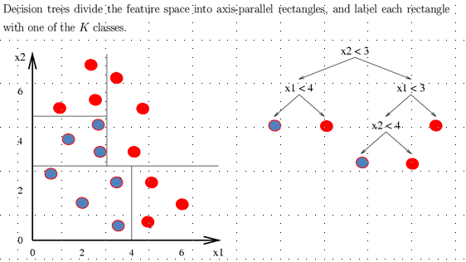
Decision boundaries

Slide 15
Why decision trees are so important
The algorithmic idea is simple and intuitive
Decision trees can learn relatively complex patterns, although there might be patterns that cannot be represented well with decision trees.
The model is interpretable to humans (we can understand why each prediction is as it is)
Decision trees are the basis to few more complex and very powerful methods, like random forests

Slide 16
Decision trees are interpretable to humans
Decision Trees and Rules
If x2<3 and x1<4 then “blue”
If x2<3 and x1>=4 then “red”
…

Slide 17
Some drawbacks of decision trees
Some decision boundaries might not be parallel to axes (decision trees are not the most general classifiers)
Decision trees might be a bit unstable: in a re-training attempt, a different set of splits might be selected. The overall performance might not change significantly, but the tree may still be different.

Slide 18
Linear regression
Let us assume that we want to assess the market price of some property.
We can collect the closing prices of deals in the relevant neighborhood.
Example

Slide 19
Univariate linear estimator
Estimated (or predicted) y value
Estimate of the regression intercept
Estimate of the regression slope
Independent variable

Slide 20
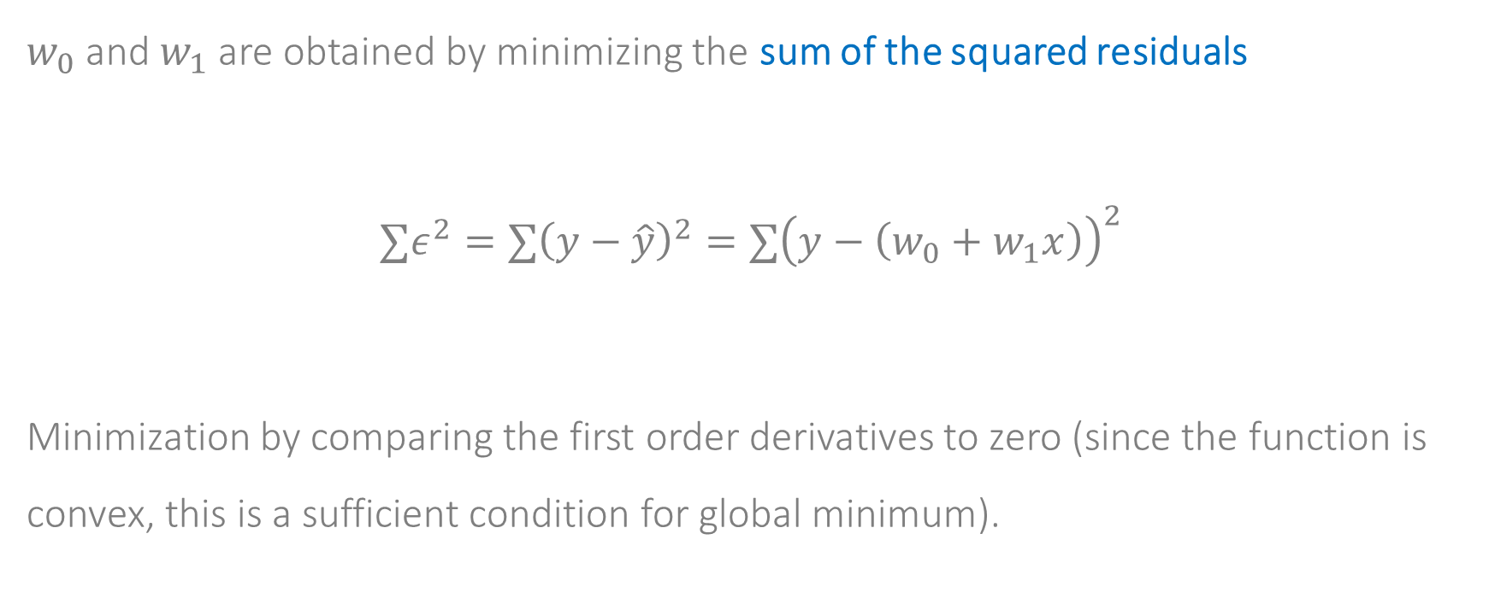
How should we compute the coefficients?
$w_{0}$ and $w_{1}$ are obtained by minimizing the sum of the squared residuals
$$∑ε^{2}=∑{\left(y−\hat{y}\right)}^{2}=∑{\left(y−\left(w_{0}+w_{1}x\right)\right)}^{2}$$
Minimization by comparing the first order derivatives to zero (since the function is convex, this is a sufficient condition for global minimum).

Slide 21
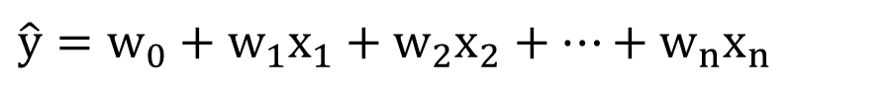

How should we compute the coefficients?
There is a simple closed-form solution to the optimization problem, and we can get a formula to $w_{0}$ and $w_{1}$.
Moving to the multivariate case is straight forward:
and we also have a closed form solution there
$$\hat{y}=w_{0}+w_{1}x_{1}+w_{2}x_{2}+…+w_{n}x_{n}$$

Slide 22
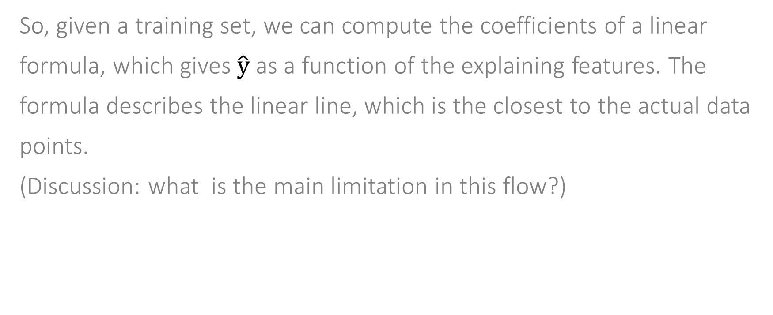
Linear regression
So, given a training set, we can compute the coefficients of a linear formula, which gives $\hat{y}$ as a function of the explaining features. The formula describes the linear line, which is the closest to the actual data points.
(Discussion: what is the main limitation in this flow?)

Slide 23
What is the dependency is non-linear
By pre-calculating non-linear combinations of the explaining features, we can apply linear regression (on higher dimensionality) and obtain non-linear dependencies.
However, we need to pre-decide on the degree of non-linearity

Slide 24
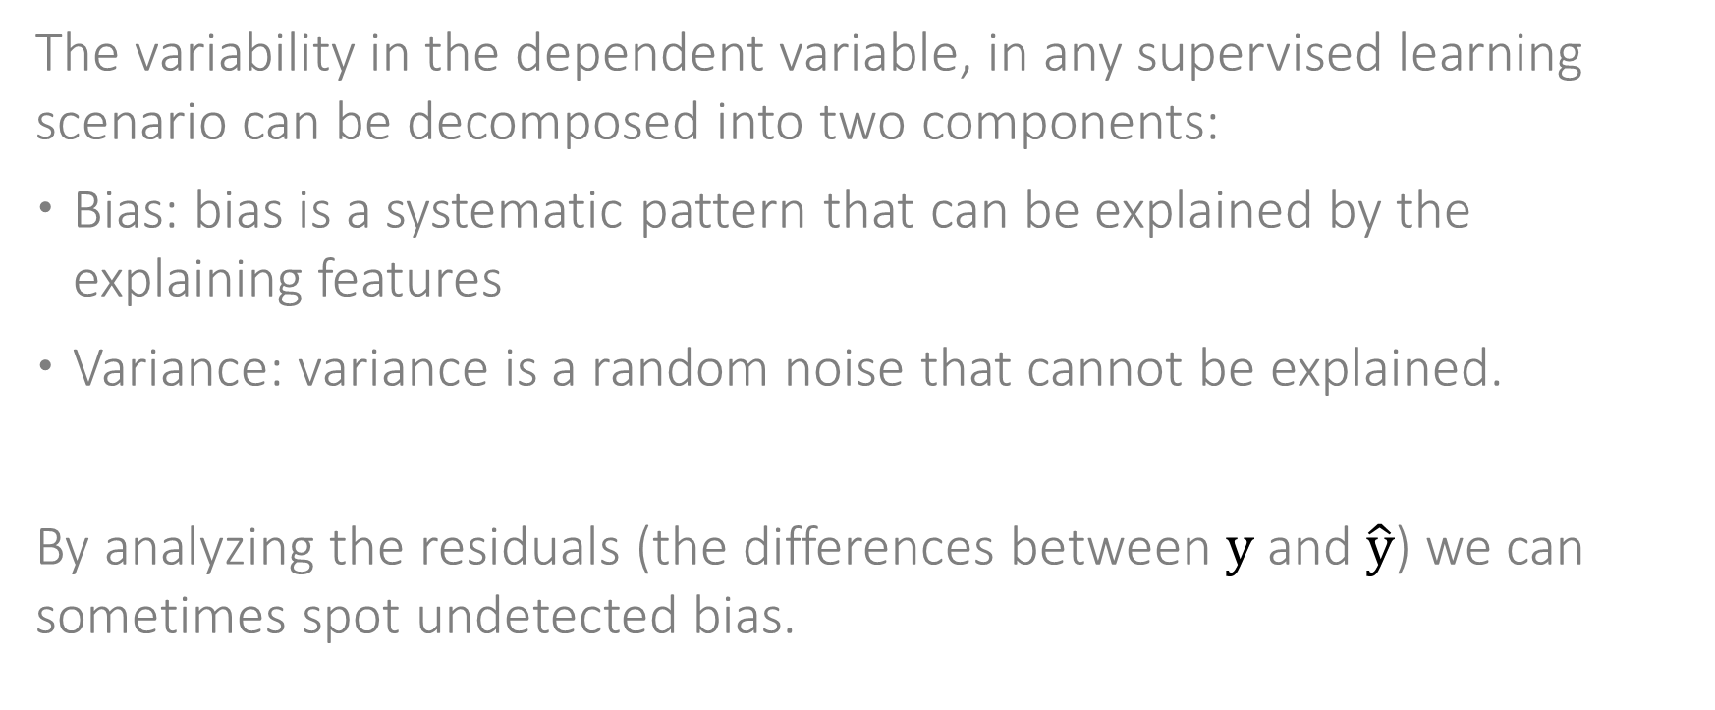
Bias and variance in linear regression
The variability in the dependent variable, in any supervised learning scenario can be decomposed into two components:
Bias: bias is a systematic pattern that can be explained by the explaining features
Variance: variance is a random noise that cannot be explained.
By analyzing the residuals (the differences between $y$ and $\hat{y}$) we can sometimes spot undetected bias.

Slide 25
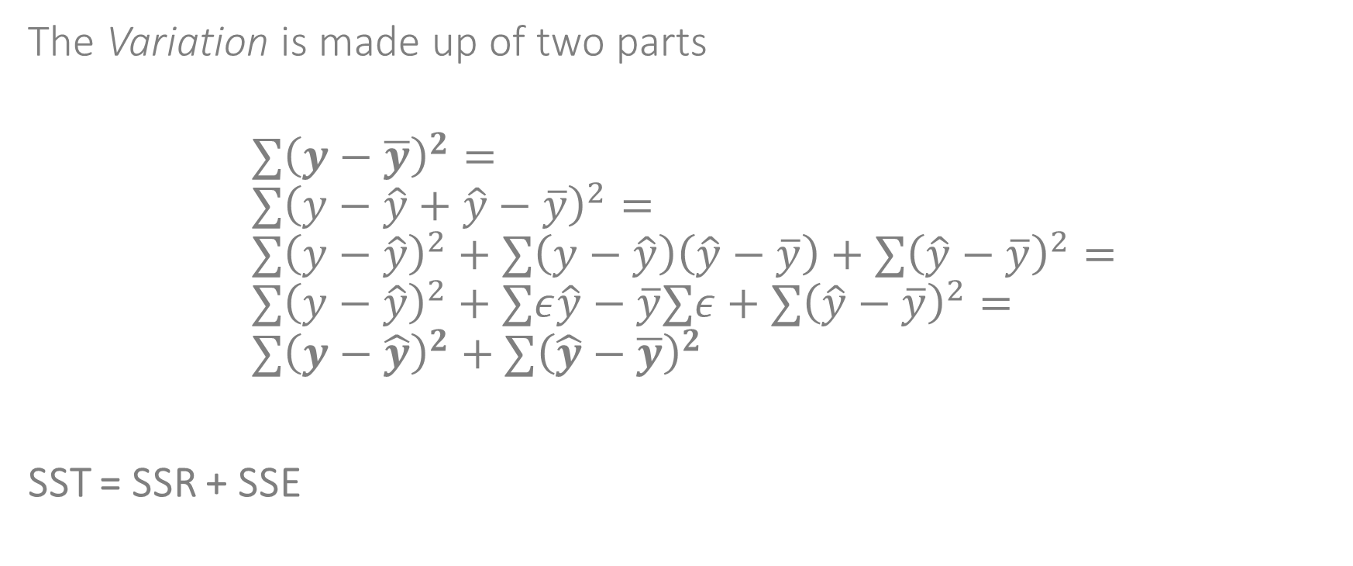
R²
The Variation is made up of two parts
$$∑{\left(y−\overline{y}\right)}^{2}= \\ ∑{\left(y−\hat{y}+\hat{y}−\overline{y}\right)}^{2}= \\ ∑{\left(y−\hat{y}\right)}^{2}+∑\left(y−\hat{y}\right)\left(\hat{y}−\overline{y}\right)+∑{\left(\hat{y}−\overline{y}\right)}^{2}= \\ ∑{\left(y−\hat{y}\right)}^{2}+∑ε\hat{y}−\overline{y}∑ε+∑{\left(\hat{y}−\overline{y}\right)}^{2}= \\ ∑{\left(y−\hat{y}\right)}^{2}+∑{\left(\hat{y}−\overline{y}\right)}^{2}$$
SST = SSR + SSE

Slide 26
R²
y
y_{i}
∧
∧
SSE = ∑(y_{i} - y_{i} )²
y
_
SST = ∑(y_{i} - y)²
∧
y
_
∧
_
SSR = ∑(y_{i} - y)²
y
y
x
X_{i}

Slide 27
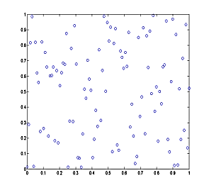
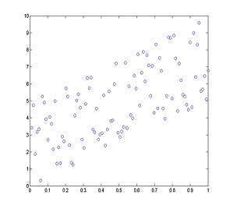
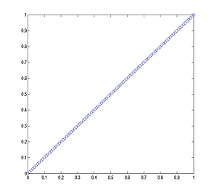



R²
R² is defined as R² =SSR/SST
$$R^{2}=0$$
$$R^{2}=0.5$$
$$R^{2}=1$$

Slide 28
R²
R² actually tests the goodness of fit: how close the data are to the fitted regression line.
It is does not come instead of the train-validation-test methodology.

Slide 29
Linear regression - summary
Model the outcome as a linear function of the independent variable
Have a closed-form solution for minimizing SSE
What if the functional relation is not linear?
What can be done of there are non-numeric explaining features?

Slide 30
Supervised learning: Decision trees and linear regression

